Slide 1
Chapter 2
Data
Representation
Program
Computer HW
(Von Neumann Model)
Input Data
Output Data
Data Type

Slide 2
OBJECTIVES
After reading this chapter, the reader should
be able to:
Define data types.
Visualize how data are stored inside a computer.
Understand the differences between text, numbers,
images,video, and audio.

Slide 3
Contents
2.1 Data Types
2.2 Data inside the Computer
2.3 Representing Data

Slide 4
2.1
DATA TYPES

Slide 5
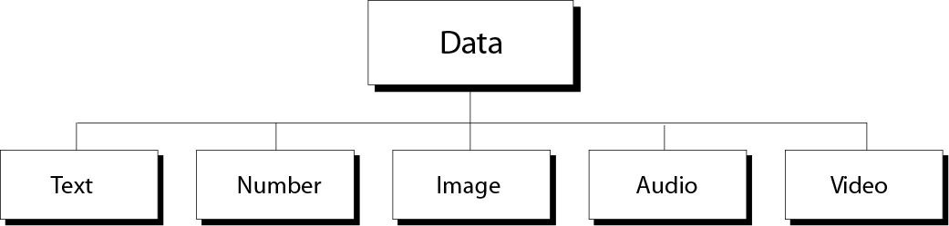
2.1 Data Types
Different types of data
Figure 2-1
Engineering Program: number.
Word processing program: text.
Image processing program: images.

Slide 6

Note:
The computer industry uses the term
“multimedia” to define information that contains numbers, text, images, audio, and video.

Slide 7
2.2
DATA INSIDE
THE COMPUTER

Slide 8
2.2 Data inside the computer
？How do you handle all these data types?
? Do you have different computers process different types of data?
All data types from outside a computer are transformed into a uniform representation when stored in a computer and then transformed back when leaving the computer.
This universal format is called a
bit pattern(位模式).

Slide 9
2.2 Data inside the computer
A bit(binary digit) is the smallest unit of data that can be stored in a computer:it is either 0 or 1.
A single bit can not possibly solve the data representation problem.
To present different types of data, you use a bit pattern, a sequence, or as it is sometimes called, a string of bits.
bit---bit pattern----byte
物理学中的原子与计算机中的位对比。

Slide 10
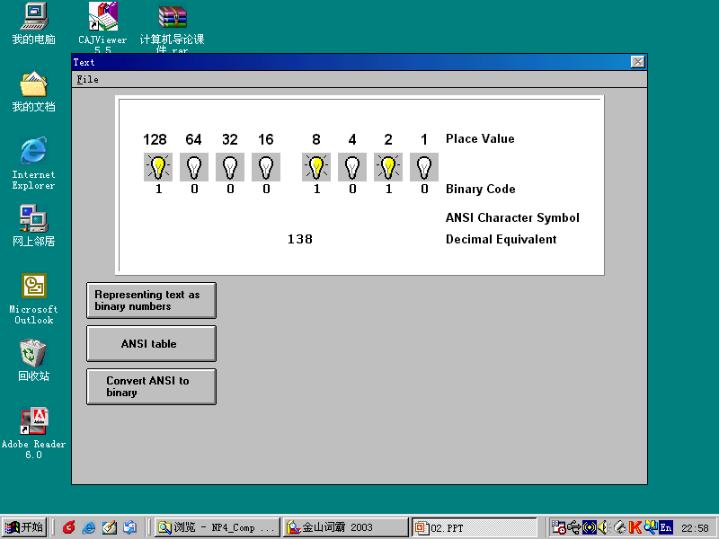
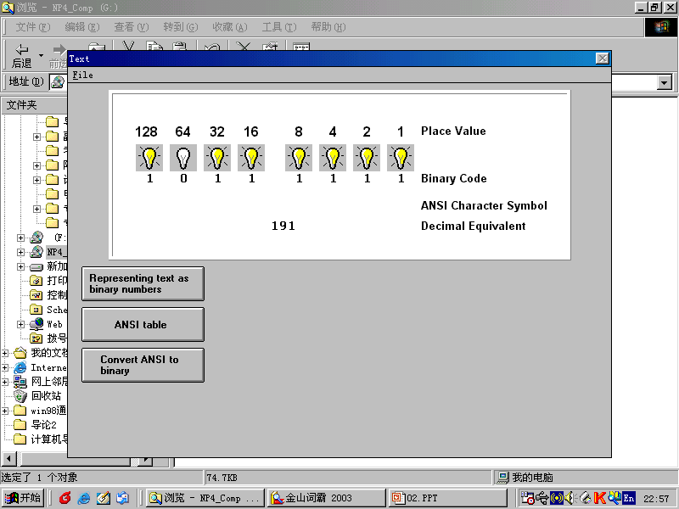
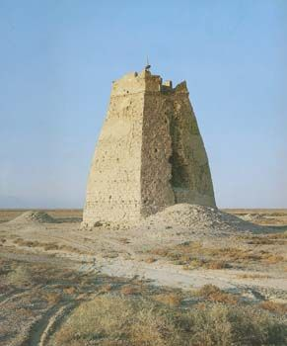
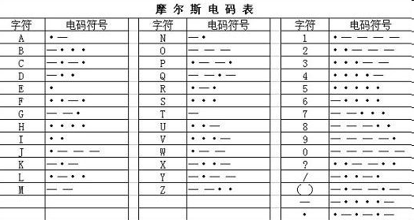
Bit pattern
Figure 2-2
Beacon Tower
Morse Code
你能用熄火台传送更多的信息吗？

Slide 11
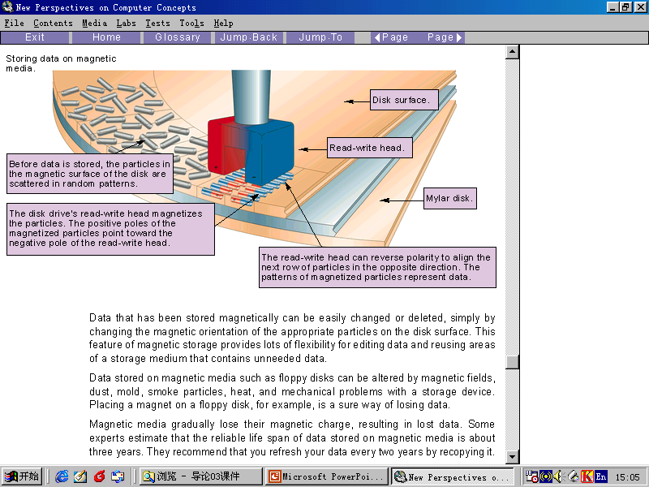
2.2 Data inside the computer

Slide 12
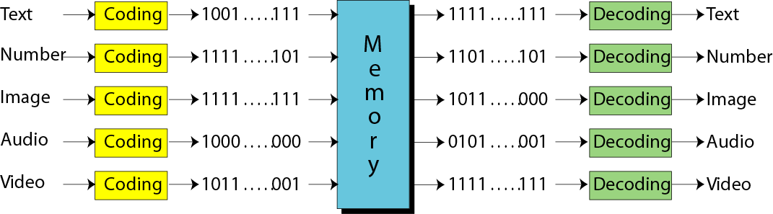
?How does computer memory know what type of data a stored bit pattern represents?
Figure 2-3
Data are coded when they enter a computer and decoded when they are presented to the user.

Slide 13
Thinking computer as
Programmable Data Processor Model
Program
Input Data
Computer HW
(Von Neumann Model)
Output Data
Data Type
Program
Storing different types of data as
universal format ---Bit Pattern
Input Data
Output Data
bit pattern

Slide 14
2.2 Data inside the computer
A bit pattern of length 8 is called a byte.
1K=2¹⁰=1024 byte，
1M=1024K=2¹⁰2¹⁰ byte
1G=1024M=2¹⁰2¹⁰2¹⁰ byte

Slide 15
2.3
REPRESENTING
DATA

Slide 16

2.3 Representing Data---Text
Representing symbols using bit patterns
Figure 2-4
You can represent each symbol with a bit pattern.
只要知道了密电码，我就知道是什么了！

Slide 17
Question
How many bits are needed in a bit pattern to represent a symbol in a language?
It depends on how many symbols are in the set.

Slide 18
2.3 Representing Data---Text
Logarithmic:
If you are need two symbols, the length is 1 bit(log₂2=1). If you are need four symbols, the length is 2 bit(log₂4=2) .
A bit pattern of 2 bits:
00 01 10 11
A bit pattern of 3 bits:
000 001 010 011 100 101 111

Slide 19
Table 2.1 Number of symbols and bit pattern length
Number of Symbols
---------------------
2
4
8
16
…
128
256
…
65,536
Bit Pattern Length
---------------------
1
2
3
4
…
7
8
…
16

Slide 20
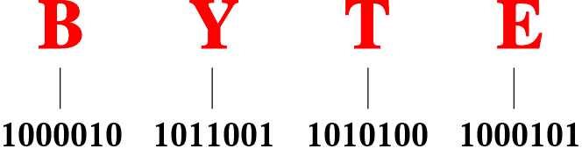
Figure 2-5
Representation of the word
“BYTE” in ASCII code
Code
Different sets of bit patterns have been designed to represent text symbols.Each set is called a code, and the process of representing symbols is called coding.

Slide 21
2.3 Representing Data---Text
The following highlights some features of ASCII code:
It uses a 7-bit pattern ranging from 0000000 to 1111111.
There are 31 control(nonprintable) characters.
The numeric character(0 to 9) are coded before letters.
The uppercase letters(A…Z) come before the lowercase letters(a…z).

Slide 22
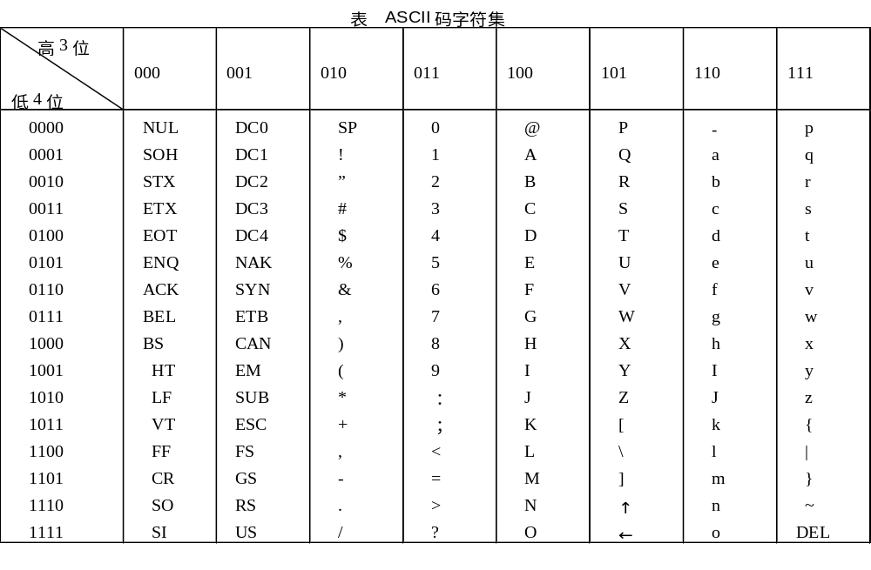
密电码，密码本！！！

Slide 23
2.3 Representing Data---Text
Extended ASCII
To make the size of each pattern 1 byte,the ASCII bit pattern are augmented with an extra 0 at the left.(00000000 to 01111111)
EBCDIC---8 bits
Unicode---16 bits
ISO—International Organization for Standardization

Slide 24
2.3 Representing Data---Numbers
Numbers are represented using binary system. But not ASCII code.
In chapter 3.

Slide 25
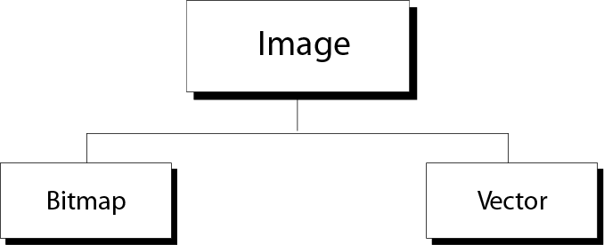
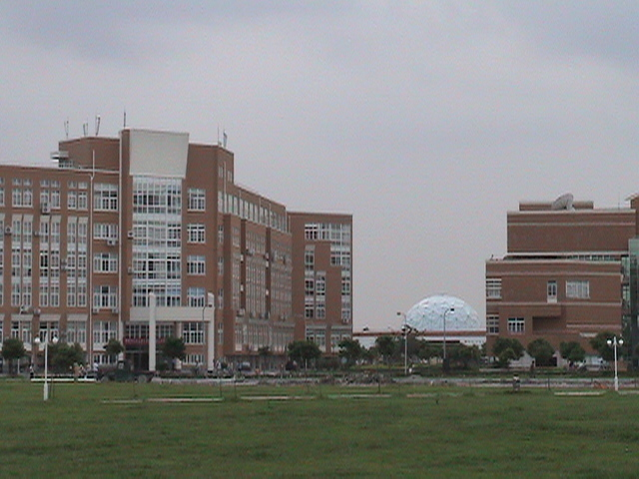
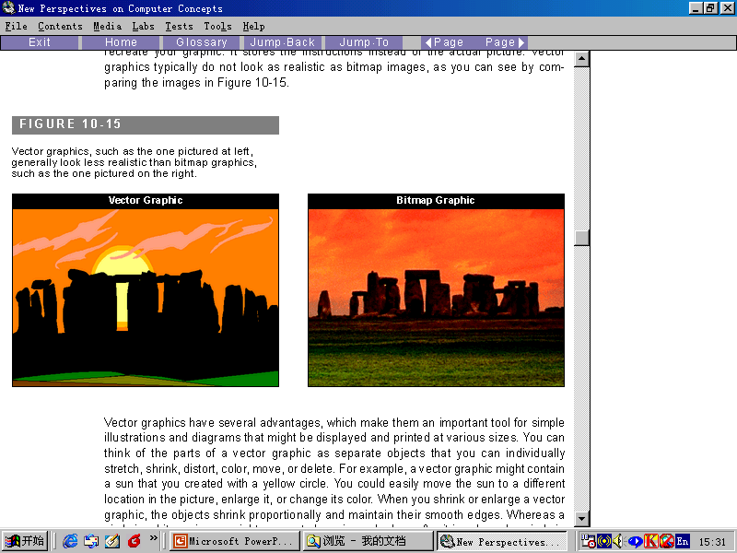
2.3 Representing Data---Images
Image representation methods
Figure 2-6

Slide 26
2.3 Representing Data---Images
Bitmap Graphic:
An image is divided into a matrix of pixels(像素), where each pixel is a small dot. The size of the pixel depends on what is called the resolution(分辩率).

Slide 27
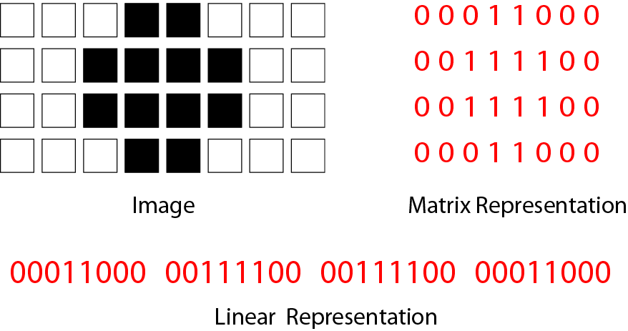
Figure 2-7(1)
Bitmap graphic method of a
black-and-white image

Slide 28
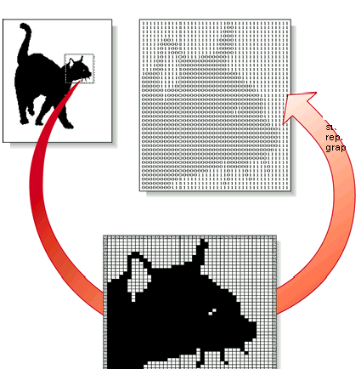
Figure 2-7(2)
Bitmap graphic method of a
black-and-white image

Slide 29
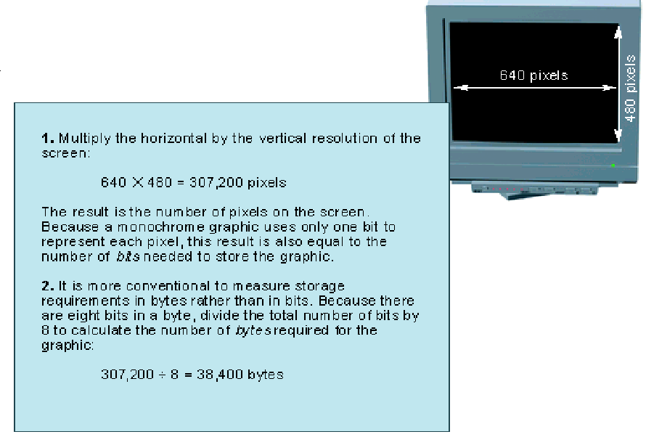

Slide 30
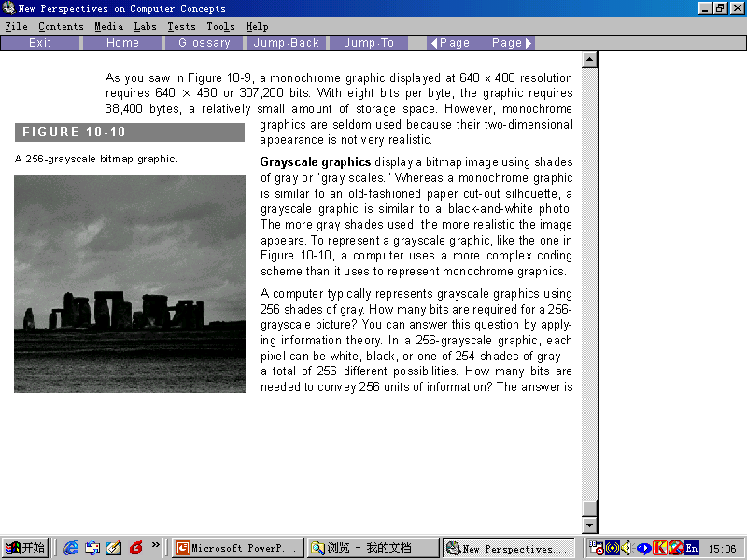
Grayscale graphics : In a 256-grayscale graphic,each pixel can be white, black, or one of 254 shades of gray- a total of 256 different possibilities.

Slide 31
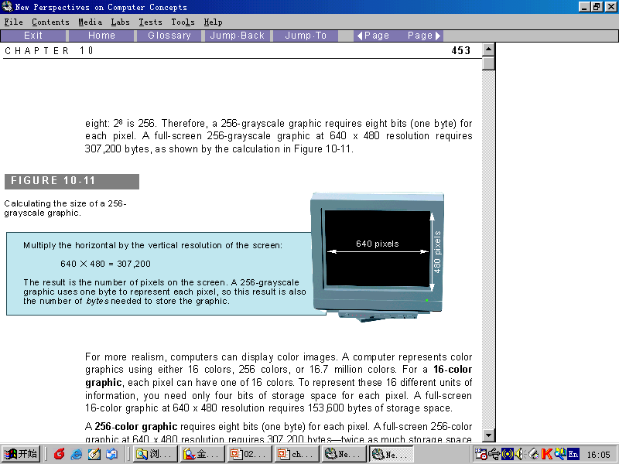
256-grayscale graphic
640×480=307200 pixel
640×480 × 8=307200 ×8 bits
640×480 ×8/8=307200 bytes

Slide 32
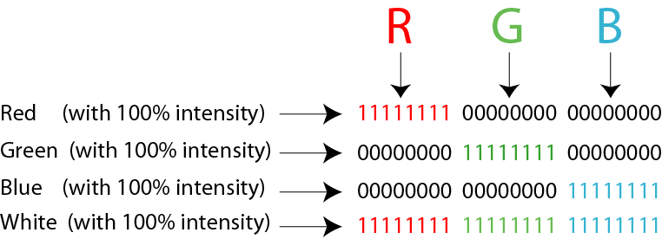
Figure 2-8
Representation of color pixels

Slide 33
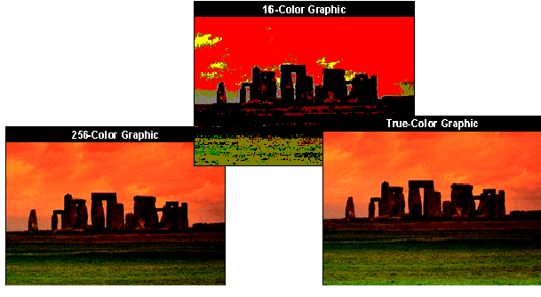
Representation of color pixels
The storage space for a 16 color、a 256 color 、or a true-color(24-bit) graphics:
16 color: 640 × 480×4/8
256 color: 640 × 480×8/8
True-color: 640 × 480×24/8

Slide 34
Vector graphics
The vector graphics method, however, does not store the bit pattern.
An image is decomposed into a combination of curves and lines.Each curve or line is represented by a mathematic formula.
The combination of these formulas is stored in a computer.

Slide 35
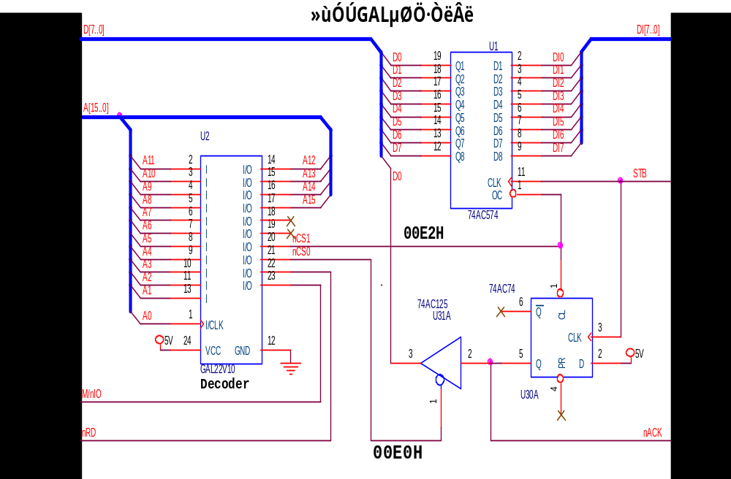
Vector graphics

Slide 36
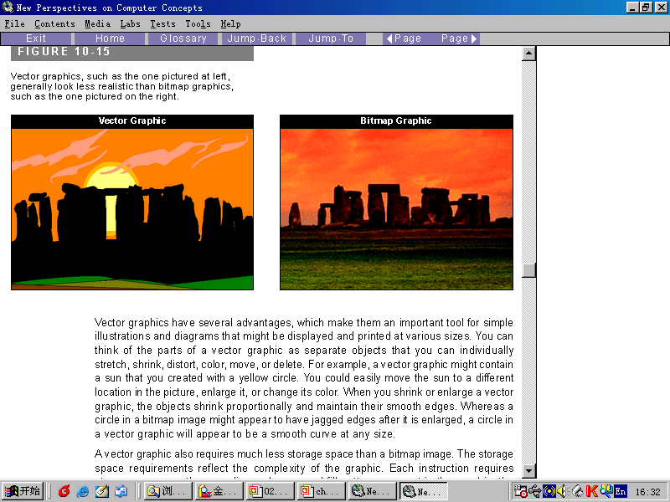

Slide 37
2.3 Representing Data---Audio
Sampling---The analog signal is sampled. Sampling means measuring the value of the signal at equal intervals.
Quantization---The samples are quantized. Quantizating means assigning a value(from a set) to a sample.
Coding---The quantized values are changed to binary pattern.
Store---The binary patterns are stored.

Slide 38
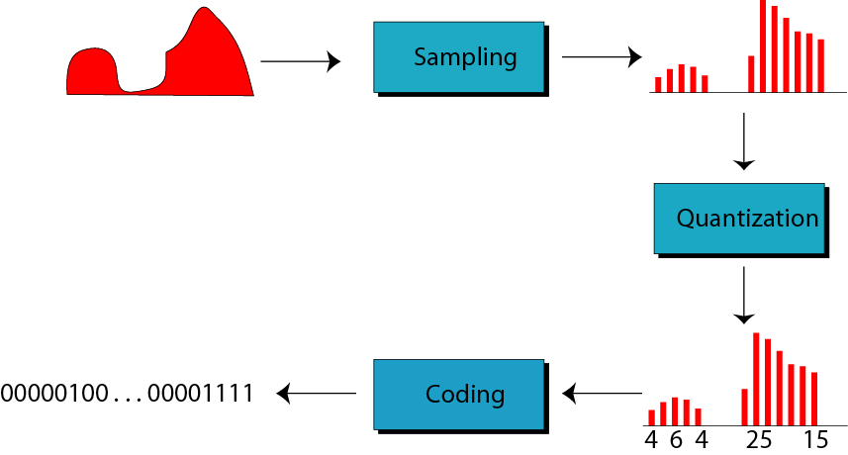
Figure 2-9
Audio representation
“现实中物理量变化是连续的。”
此话对？中观。
“计算机中表示是离散的”

Slide 39
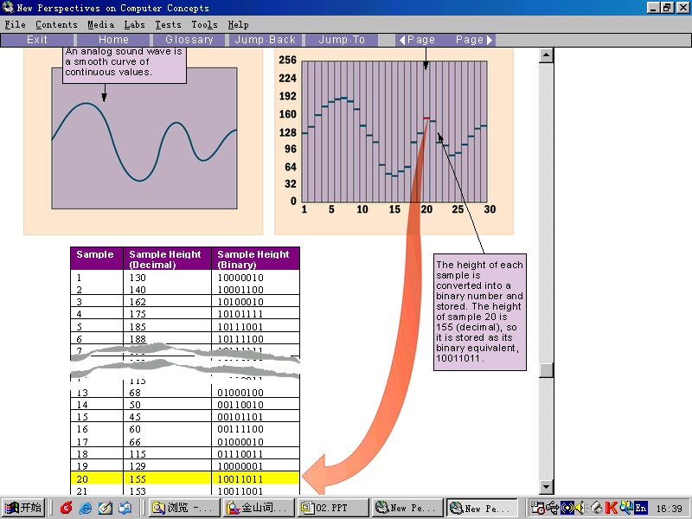

Slide 40
2.3 Representing Data---Video
Video is a representation of images(called frames).
See chapter 15.

Slide 41
2.4 Hexadecimal Notation
Hexadecimal Notation is based on 16.
16 symbols(hexadecimal digit):
0,1,2,3,4,5,6,7,8,9,A,B,C,D,E,F
each symbols represents 4 bits.
A 4-bit pattern can be represented by a hexadecimal digit.

Slide 42
Hexadecimal digit
Bit Pattern | Hexadecimal digit | Bit Pattern | Hexdecimal digit
0000 | 0 | 1000 | 8
0001 | 1 | 1001 | 9
0010 | 2 | 1010 | A
0011 | 3 | 1011 | B
0100 | 4 | 1100 | C
0101 | 5 | 1101 | D
0110 | 6 | 1110 | E
0111 | 7 | 1111 | F

Slide 43
Example
Example1: Show the hexadecimal equivalent of the bit pattern
110011100010
Solution: xCE2
Example 2: Show the hexdecimal equivalent of the bit pattern
0011100010.
Solution: x0E2
Example 3: What’s the bit pattern for x24C?
Solution: 001001001100

Slide 44
2.5 Octal Notation
Hexadecimal Notation is based on 8.
8 symbols(octal digit):
0,1,2,3,4,5,6,7
each symbols represents 3 bits.
A 3-bit pattern can be represented by a octal digit.

Slide 45
Octal digit
Bit Pattern | Octal digit | Bit Pattern | Octal digit
000 | 0 | 100 | 4
001 | 1 | 101 | 5
010 | 2 | 110 | 6
011 | 3 | 111 | 7

